Slide 1
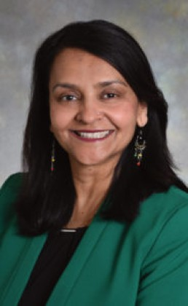
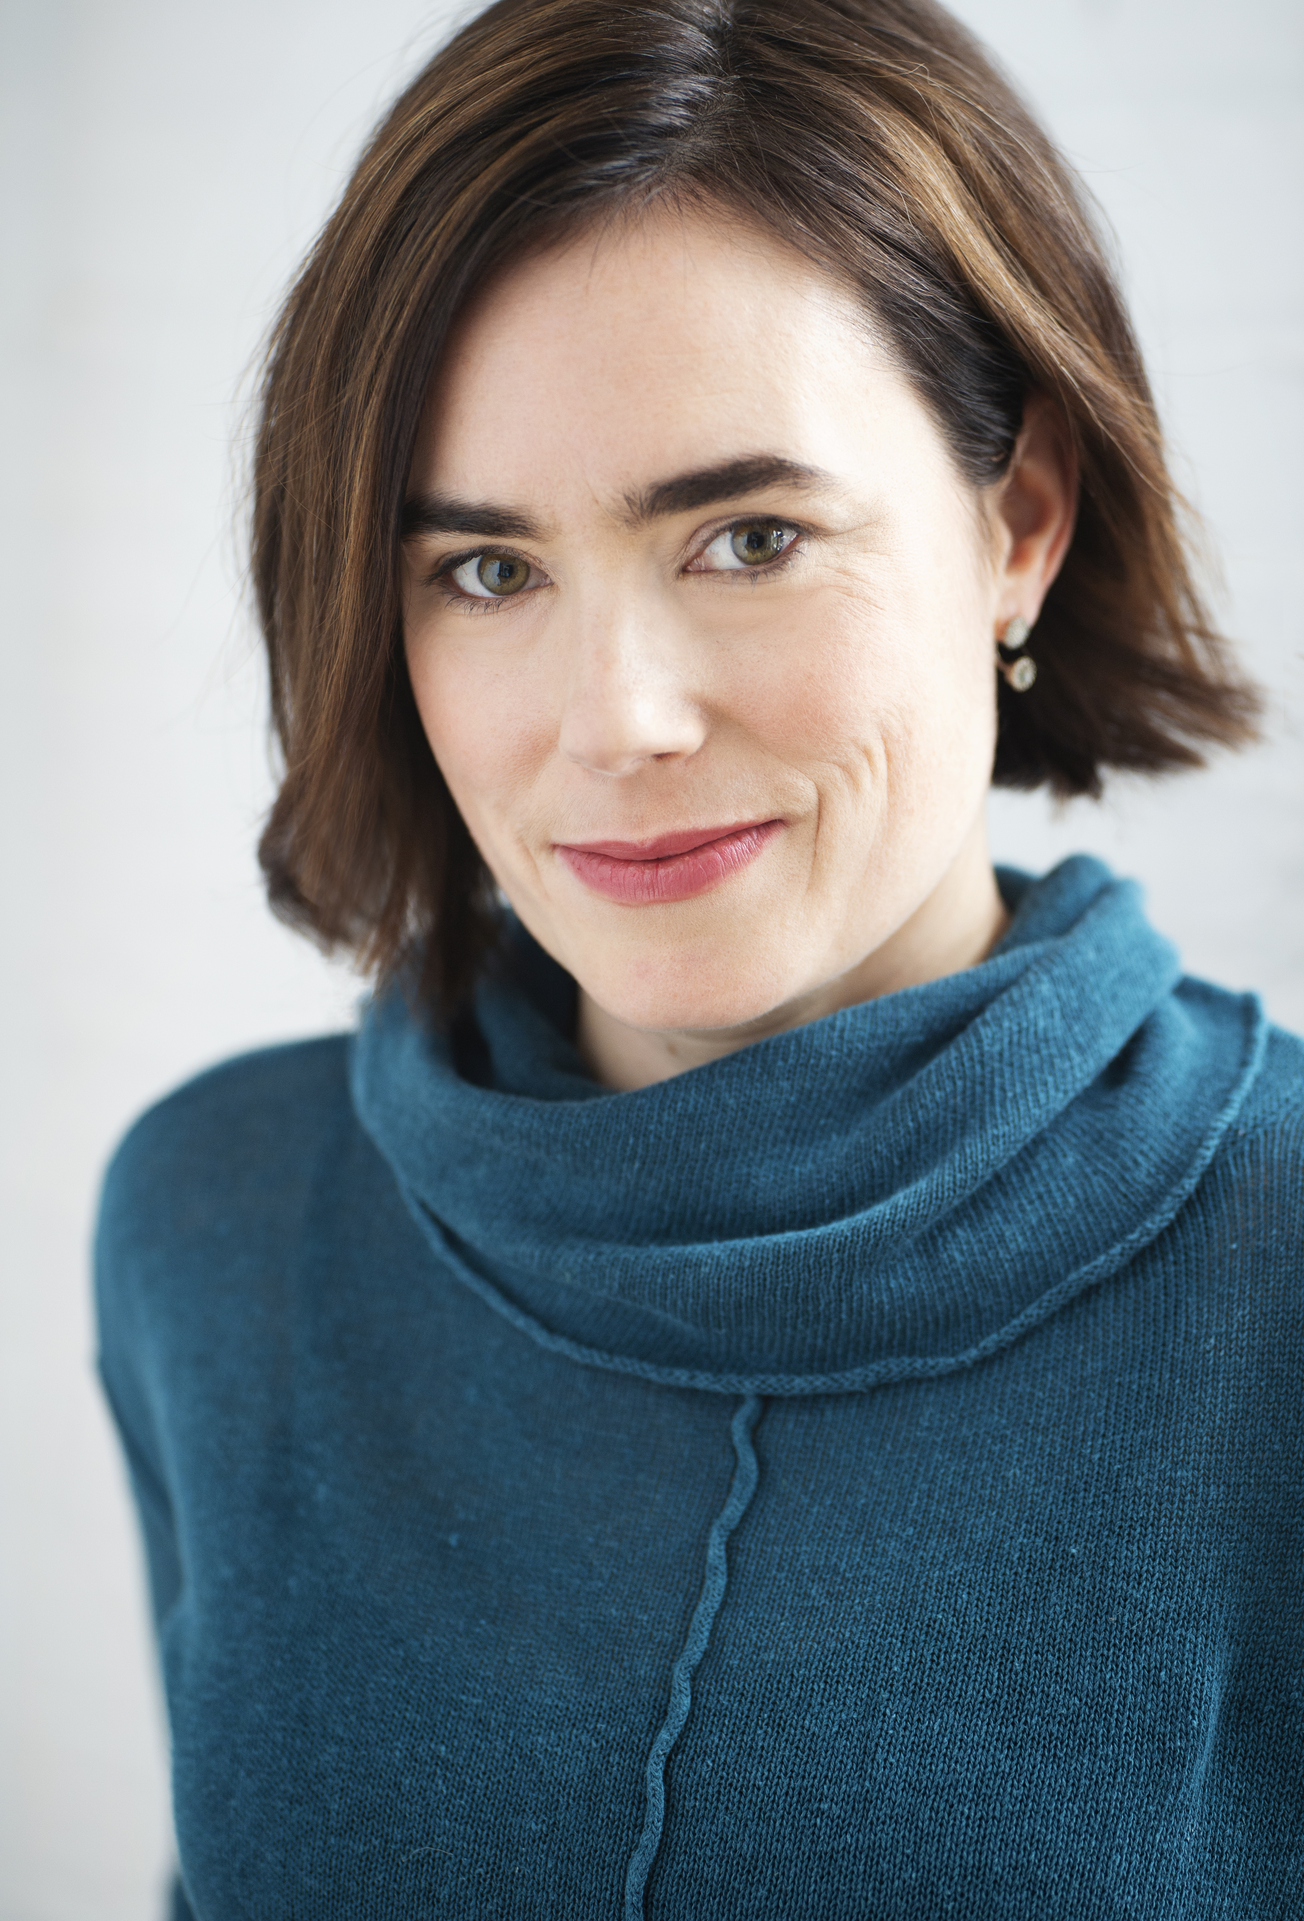
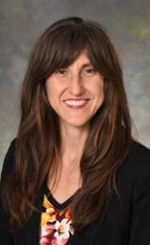
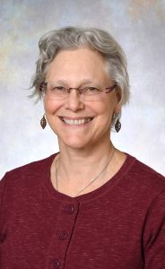
Planning and Implementing Integrative Health Project ECHO
(Extension For Community Healthcare Outcomes)
Programs
Arti Prasad, MD, FACP, CPE, CPDC
Catherine Justice, DPT, C-IAYT
Kate Shafto, MD
Susan Haddow, MD
Division of Integrative Health and Wellness
Notes:
Dr. Prasad to present – quick intro for each team member
What our training and certifications are
Name our bias – we are all ECHO devotees!

Slide 2
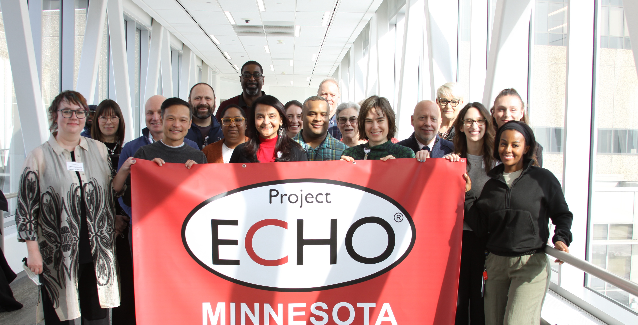
ACKNOWLEDGEMENT
Notes:
Arti

Slide 3
Centering – Quick Coherence
Use the power of your heart to balance thoughts and emotions to achieve energy and mental clarity.
Helps reduce stress in the moment.
Feel positive, focused, calm and energized.
Perform at your best.
Access creativity, intuition and higher-level decision making.
Notes:
Sue

Slide 4
Transforming the Health of our Community – Exceptional Care without Exception
Our Mission
Notes:
Dr Prasad

Slide 5
Objectives
Understand the “All Teach, All Learn” Project ECHO Model ​
Explore how Project ECHO has the potential to increase access to Integrative Medicine in rural and other underserved areas and populations ​
Experientially and collaboratively plan the design and implementation of an Integrative Health-themed Project ECHO ​
Notes:
Dr Prasad

Slide 6
University of New Mexico UNM Hospital (1990-2017)
Notes:
Dr Prasad

Slide 7
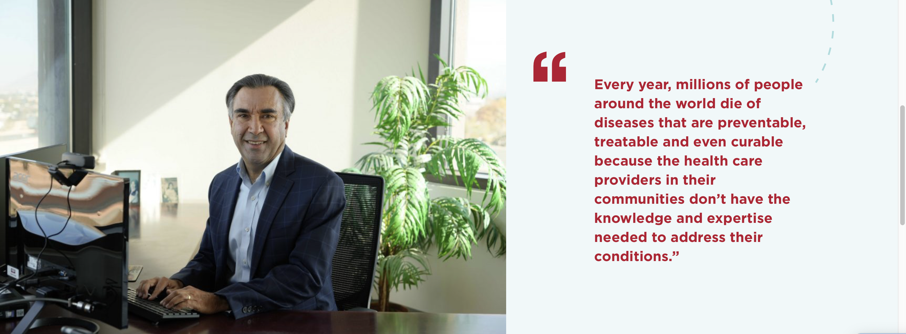
Dr. Sanjeev Arora, Founder and Director of Project ECHO
Founding goals:
Develop capacity to safely and effectively treat Hepatitis-C (HCV) in all areas of New Mexico and to monitor outcomes.
Develop a model to treat complex diseases in rural locations and developing countries.
Notes:
Dr Prasad

Slide 8
Moving Knowledge, Not People
Notes:
Dr Prasad

Slide 9
At ECHO, our mission is to democratize implementation of best practices for health care and education to underserved people all over the world.
Notes:
Dr Prasad

Slide 10
The ECHO Model
Copy Righted slides used with permission
Notes:
Dr Prasad

Slide 11
An ECHO Hub...
Trains physicians, physician assistants, nurse practitioners, nurses, pharmacists, educators in HCV
Trains to use web-based software — iECHO & ECHO Health®
Conducts ECHO sessions — “Knowledge Networks”
Initiates case-based guided practice — “Learning Loops”
Collects data and monitors outcomes centrally
Assesses cost and effectiveness of programs
Notes:
Dr Prasad
Learning Loops means they will learn from experts, from each other and then learning by doing to become expert themselves

Slide 12
Spoke
Spoke
Spoke
HCV was our flagship Program
HUB
Spoke
Spoke
Spoke
Spoke
Notes:
Dr Prasad

Slide 13
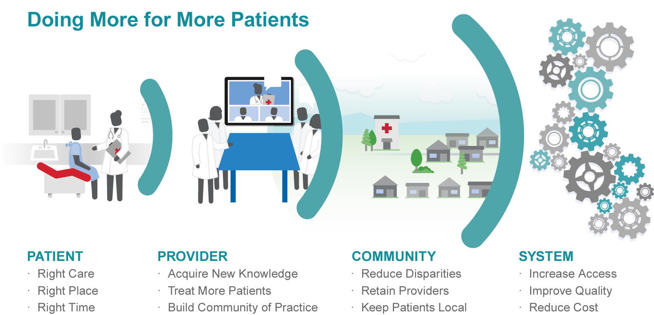
Benefits from Project ECHO
Notes:
Dr Prasad

Slide 14
ECHO creates VALUE for all parts of the healthcare system
Patients
Community
Community Clinics
Providers (spoke)
Providers (hub)
Payers
Rural Clinicians
It is very important to not simplify this to Return on Investment (ROI) equation, but rather as a VALUE EQUATION. ECHO may deliver ROI, but it has a much greater value impact on all segments of the health care system.
Notes:
Dr Prasad

Slide 15
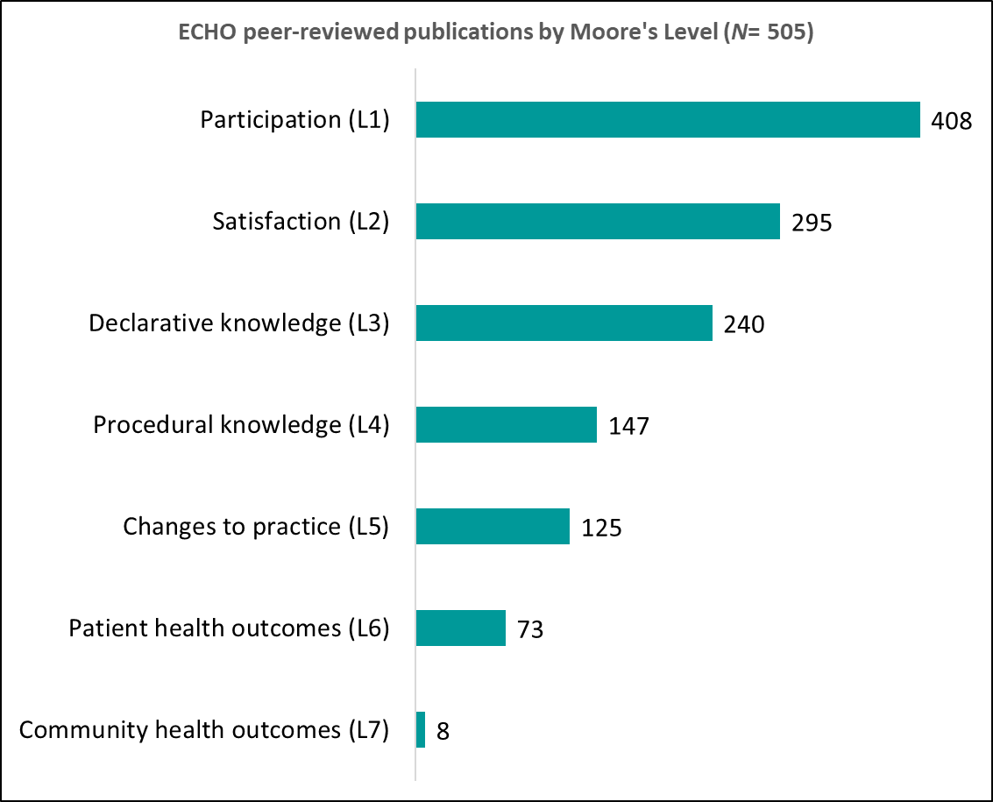
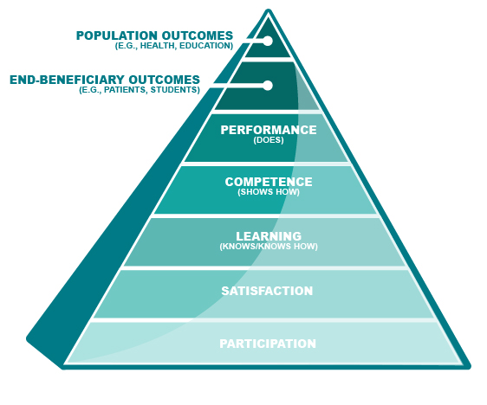
ECHO Publications by Outcome Levels
500+ Publications
Notes:
Dr Prasad

Slide 16
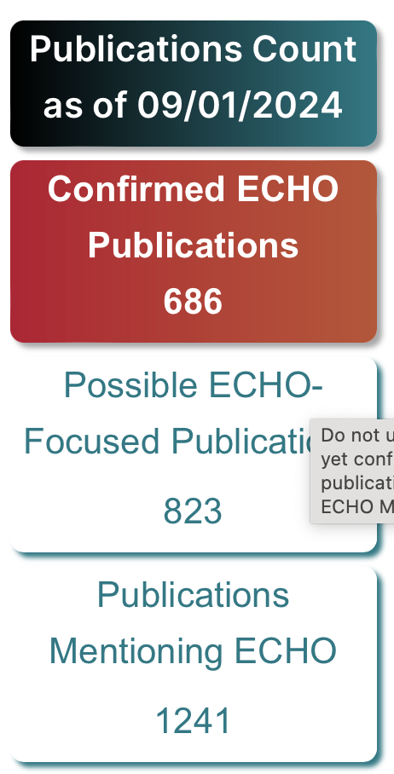
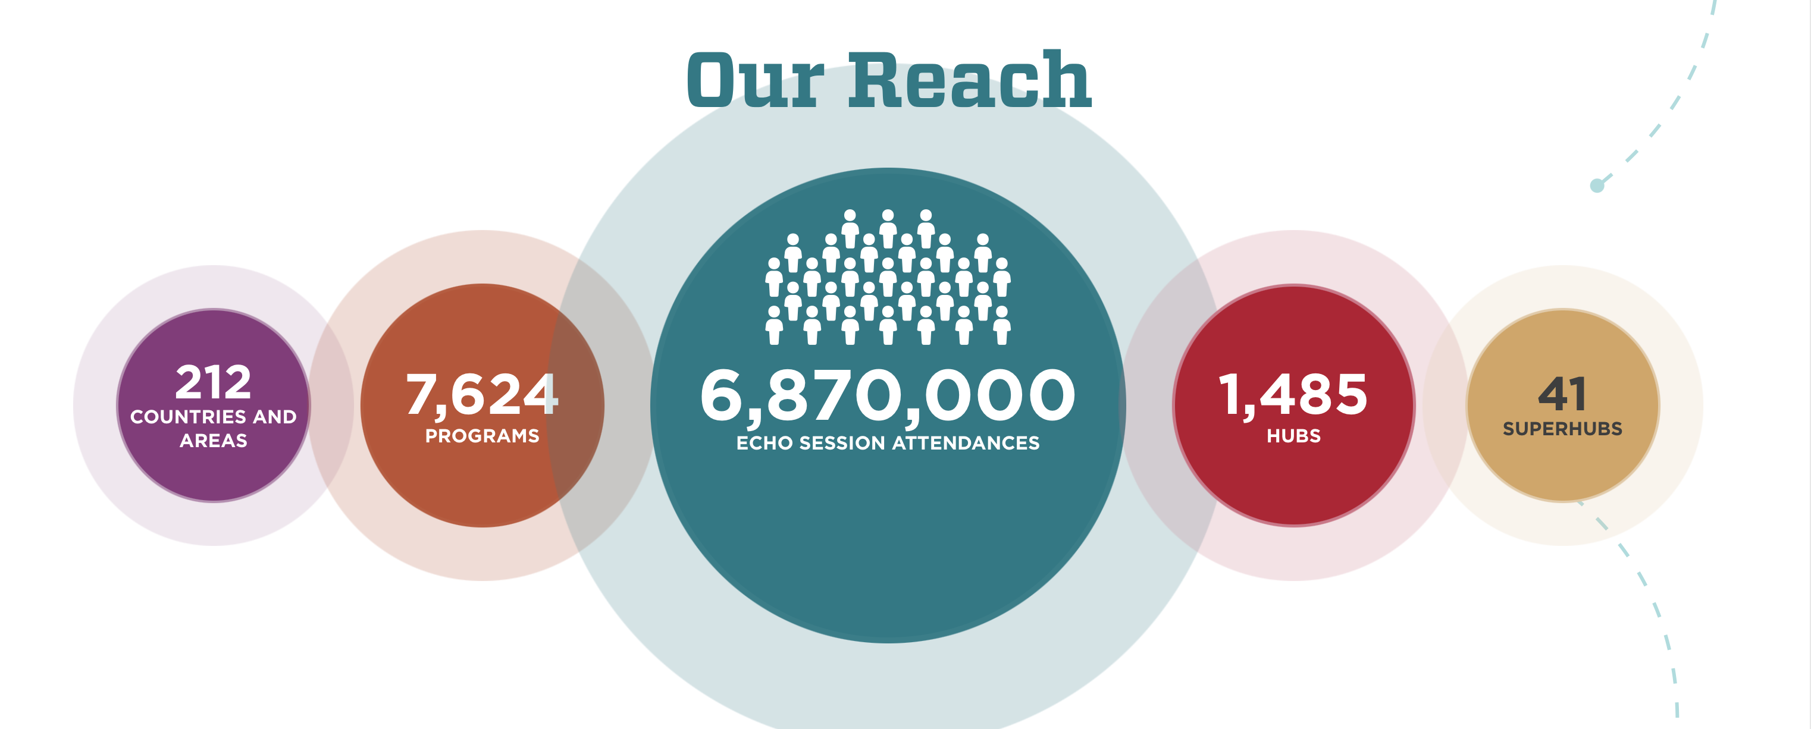
Notes:
Dr Prasad

Slide 17
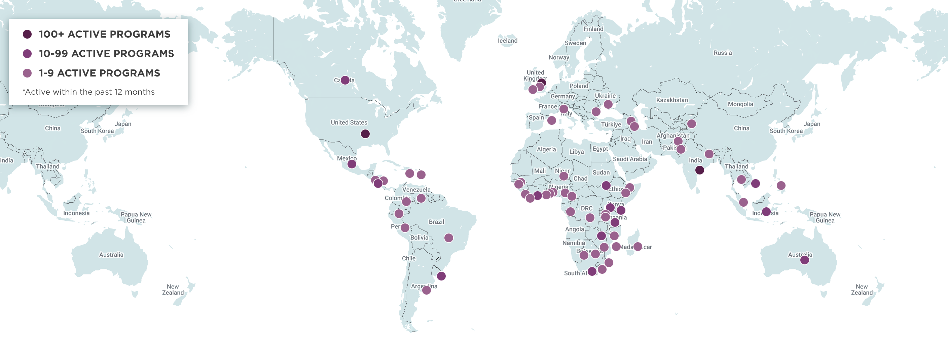
ECHO AROUND THE WORLD
Notes:
Dr Prasad

Slide 18
New Mexico to Minnesota
Notes:
Dr Prasad

Slide 19
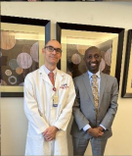
Advocacy for Project ECHO
Notes:
Dr Prasad

Slide 20
ECHO MN (HHS-Arti Prasad)
MN Community Collaborative on Viral Hepatitis (Jesse Powell)
MN Geriatrics (UMN, HCMC – Emily Escue)
Integrated Opioid and Addiction Care (Brian Grahan)
Integrative Pain Care (Susan Haddow, Kate Shafto, & Catherine Justice)
Peer Recovery Support Training (Cole Pueringer, Catherine Justice, DPT, & Caddy Frink)
Community Health Worker Training (Cole Pueringer, Catherine Justice, DPT, & Angela Fields)
Perinatal Substance Use (Lauren Graber, Cresta Jones)
Communicate Care Fellowship for Eliminating Racism in Substance Use ECHO (Cuong Pham, Cedric Weatherspoon)
Trauma-Informed Care & Health Equity (Mitch Radin, Tegan Carr, & Catherine Justice)
Upper Midwest Nursing Home COVID-19 (HCMC, UMN)
NEW BRANDING - ECHO MINNESOTA (2023 - present)
Notes:
Dr Prasad

Slide 21
History of Project ECHO at Hennepin Healthcare (2018 - 2026)
Addiction ECHO
Integrated Opioid and Addiction Care ECHO
MN Community Collaboration on Viral Hepatitis ECHO
MidWest Tribal ECHO
MidWest Tribal ECHO
Nursing Home COVID-19 ECHO
MN Geriatrics ECHO
Perinatal SU
Perinatal SU 2.0
Perinatal SU Workforce Development Grant
Racism SU
Racism SU 2.0
Integrated Pain Care
Trauma-Informed Care
Peer Recovery
CHW ECHO
2018
2019
2020
2021
2022
2023
2024
2025
2026
Notes:
Dr Prasad

Slide 22
Steps for Replication (ECHO Fidelity)
Orientation is just the beginning…
Next you sign partnership documents
Begin planning budget and seek funding
Design the project (target audience, curriculum, resources, community needs, evaluation strategy and tools …)
Develop your team – experts and staff
Bring a team for full training (3 days – Immersion)
Continue to develop curriculum, begin to recruit spokes/participants
Build organizational buy-in
Practice before you launch – get feedback
Launch!
Continue to seek input and reflection, constant QI
Publicize your success – money follows successful ECHOs (not the other way around)
Copyright 2017 Project ECHO®, used with permission
Notes:
Dr Prasad

Slide 23
Partnership Documents: Guiding Principles
Collaboration with ECHO requires:
Replication Statement of Collaboration – Front-end document that outlines the roles and responsibilities of both partners in any replication collaboration.
IP Terms of Use Contract – Legally binding agreement that details all the elements of the Statement of Collaboration, with a specific focus on Intellectual Property issues.
What do you agree to?
Following the ECHO mission and model
Using the ECHO name and trademarks
Mutual expectation of sharing
Using iECHO
Not selling ECHO IP to outside 3rd parties
Non-exclusivity
Copyright 2017 Project ECHO®
Notes:
Dr Prasad

Slide 24
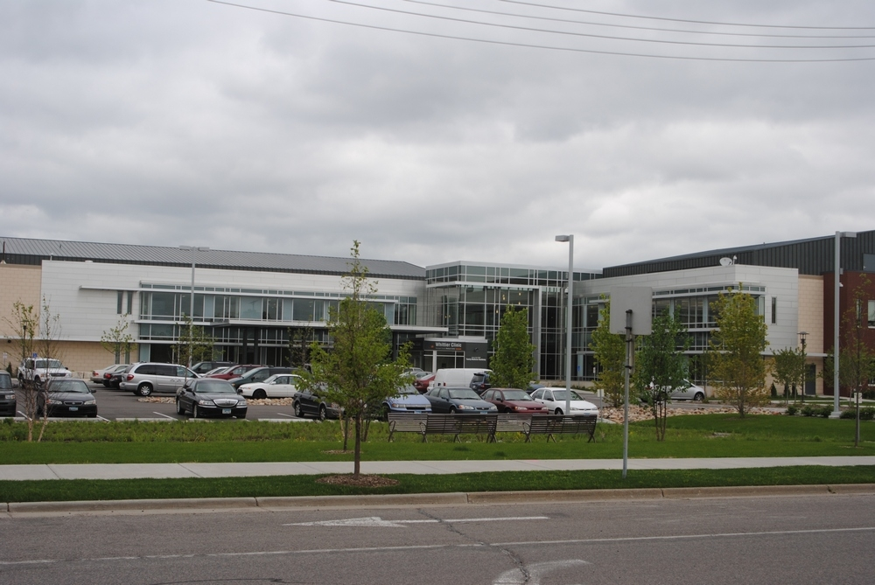
Case – Sue Haddow
My context:
Family doc, urban underserved population, residency training program.
Provide integrative primary care.
3 other IH providers in our clinic.
We all have closed practices! Our colleagues often ask us questions about various aspects of IH.
How can I help spread info without having everyone do a fellowship?
Notes:
Sue

Slide 25
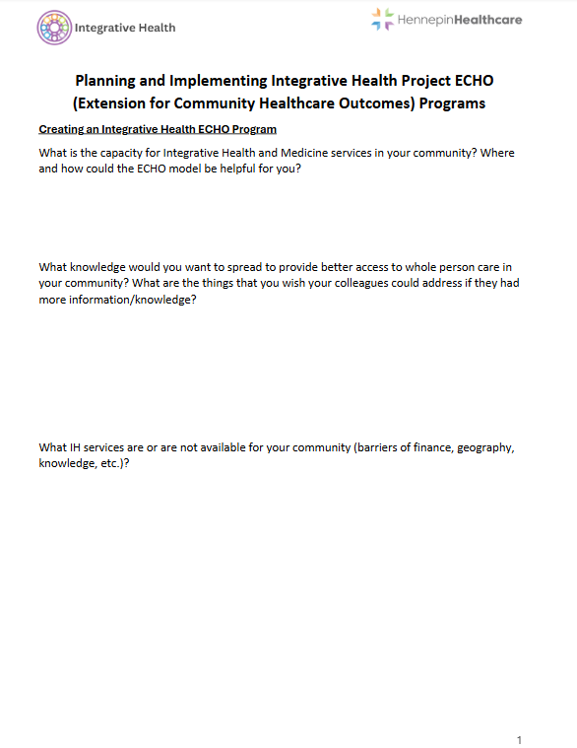
Workshop Breakout
In your groups, use the worksheet to discuss and make notes on the following:
What is the Integrative Health capacity in your community?
Where and how could the ECHO model be helpful for you?
If you could wave a wand and spread knowledge – what knowledge would you want to spread?
What are the things that your colleagues could address if they had more information/knowledge?
What IH services are or are not available for your community (barriers of finance, geography, knowledge, etc.)?
Notes:
Kate

Slide 26
Choosing an ECHO Topic
Three Criteria:
High Disease Burden
High Cost
Low Access
Notes:
Cat
Sample Topics:
DM
CA
Weight Management
CVD
Stress Management
Nutrition
etc.

Slide 27
ECHO Secrets of Success: Pick the Right Topic
Community needs/gaps in care
Availability/interest of hub team members
Fits the interests of community providers/spoke champions
More or less protocol-driven?
External motivators: chronic pain, HCV, rheumatology, HIV
Some diseases/topics find more traction
Not too broad, not too narrow
Copyright 2017 Project ECHO® used with permission
Notes:
Cat

Slide 28
Case: "I'm the only one in the system..."
Context: New Integrative Pain Care (IPC) consults in Interventional Pain Clinic
Problem: many referrals, quickly exceeded capacity, frequent in-box messages from colleagues asking about supplements, diet, etc.
Response:
Started I-GMV program (MDH funding)
Resident and faculty IPC education (informal and formal)
Recognition that there was more education needed on IPC
Notes:
kate

Slide 29
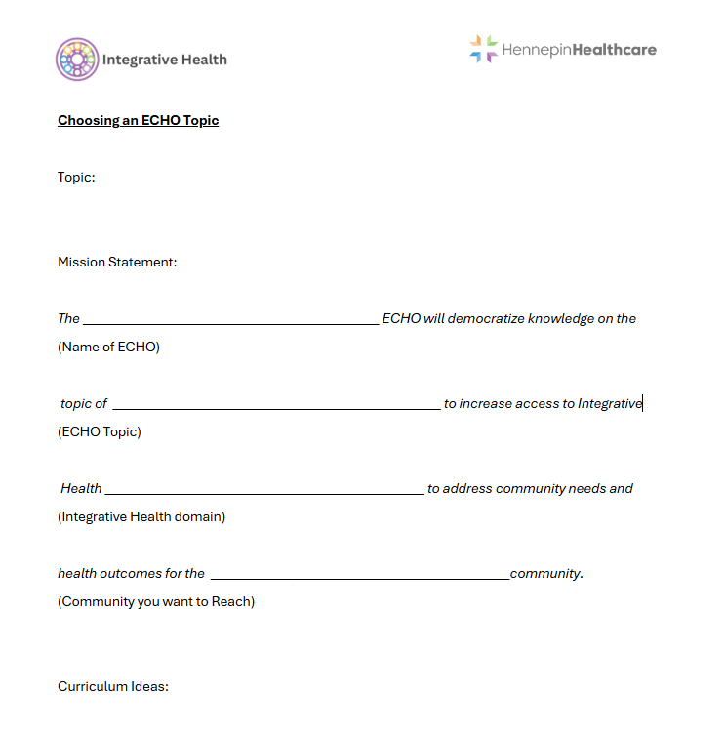
Workshop Breakout: ECHO Topics
Pick a topic
Mission Statement
Sample Curriculum*
*teach and translate IH materials to non-IH colleagues
Notes:
Cat

Slide 30
Planning and Implementing your IH ECHO
Funding
Collaborative Team
Importance of ECHO Coordinator
Hub Director
Co-Leads
SME’s
Spokes
Stakeholders - who will be impacted by and/or support the program?
Outreach and Marketing
Notes:
SUE (Dr Prasad to talk on Funding)
Check on PEARL for a sample budget
Direct Benefits:
Visibility
Training opportunities for your staff and larger community
Making a difference in community health outcomes
Provider satisfaction
Connection and collaboration across diverse professions
Spokes - improves confidence and decreases stress/burnout
CME
Easy to access teachings
Indirect Benefits:
Disease burden reduction across a larger geographic region
Keeping healthcare funds and delivery local - cost savings across the system
Improved access across wider geographic areas

Slide 31
Case
Trauma Informed Care and Health Equity ECHO
Mission
Diverse Team
Format
Curriculum
Notes:
Cat
History:
2020 – Hospital board made a commitment to improve HE with TIC principles – unique situation with George Floyd's murder
Mission:
The Trauma Informed Care and Health Equity ECHO will explore trauma and its impact within patients and healthcare workers as well as the context each of them brings to the healthcare encounter and the larger context of the healthcare system and larger society. Through ECHO sessions, we will broaden and deepen understanding of trauma for improved healthcare outcomes, improved delivery of healthcare, provider/healthcare worker wellbeing. We recognize that trauma is bigger than just a patient experience - it lives within providers/healthcare workers and within our histories and systems. Through appreciating the complexity of trauma and the interrelated factors that influence experiences of trauma and trauma recovery, we aim to take an active role in transforming our healthcare system to promote safety and healing and deconstruct systemic barriers to wellbeing for everyone.
Leadership Team:
MDs, PT, Psychology, HE Program Director – Community violence prevention, chaplain, community activist
SMEs: yoga/meditation/community activist, MD, chiropractor, invited speakers (primary care, DEI programming, etc)
Format / Curriculum:
TIC ECHO is more about how we process trauma internally ourselves, through our bodies, personal experience.
Format: we are our own cases, asking participants to delve into deep self-inquiry to better understand how TIC and HE can be better realized in their body, life, and work

Slide 32
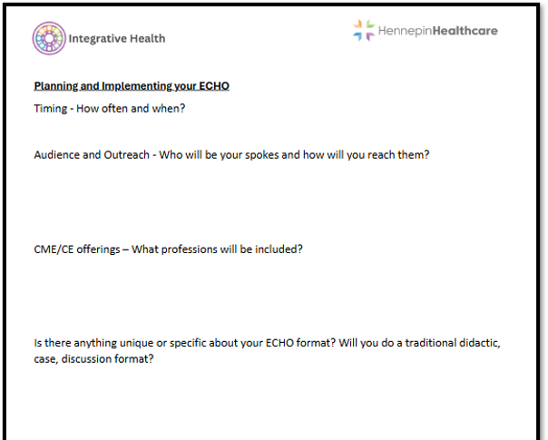
Workshop Breakout: ECHO Planning
Timing
Spokes
ECHO format
CME/CE
Notes:
Sue
ECHO Format: – didactic and discussion balance
Timing - How often and when?
Spokes - Who will you reach out to?
CME/CE offerings – what professions?

Slide 33
Key Ingredients for a successful ECHO
Attendance
Geographical reach
Engagement of spokes
ECHO team experience
Research outcomes
Notes:
Kate

Slide 34
Impact and Evaluation
All teach, All learn
Team derief, review feedback, adapt process
Dry run w/ presenters, preview of cases
Shared responsibility for engaging participants
KSA (Knowledge, Skills, Attitudes) survey – developed by team; offered after each session
Notes:
Kate
We're in process! Share stories about team process and evolution, debriefing, adapting our process over time w/ feedback from ECHO; doing a “dry-run” w/ presenters; how to engage participants, evaluation and feedback
What makes a successful ECHO?
Attendance
Geographical reach
Engagement of spokes
ECHO team experience
Research outcomes
Impact/evaluation - KSA development in process

Slide 35
Workshop Breakout: ECHO Vision
Write a Vision Statement: if your ECHO was successful, what world would we see?
Notes:
Cat

Slide 36
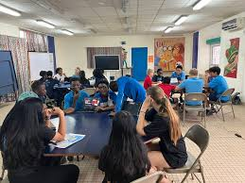
Celebrate Success!
Small Group Presentations
Notes:
Cat

Slide 37
You just attended a Project ECHO session!
Notes:
Dr Prasad

Slide 38
We are grateful for many things!
State legislature’s generous funding
Department of Human Services (DHS)
Hennepin Healthcare Foundation
Our spokes/learning communities
Our MN wide community of residents and patients
Our internal and external ECHO team members
Notes:
Dr Prasad

Slide 39
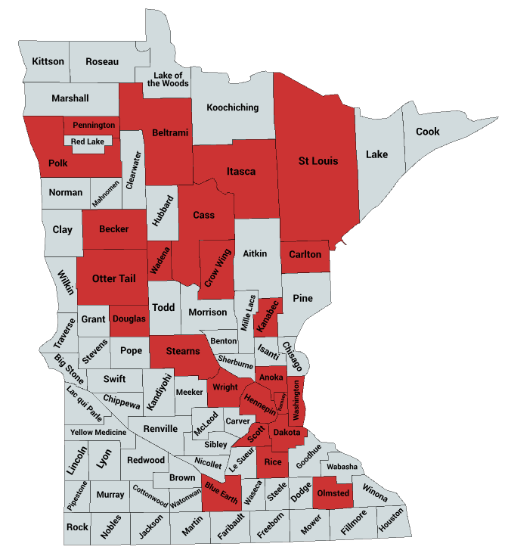
MINNESOTA
The 24 counties reached by Project ECHO Minnesota in 2024.
Notes:
Dr Prasad

Slide 40
catherine.justice@hcmed.org
arti.prasad@hcmed.org
susan.haddow@hcmed.org
kate.shafto@hcmed.org
Notes:
Dr Prasad

